Slide 1
I210 – Introduction to Programming with Python
Lecture 9

Slide 2

Today
Default Arguments
Keyword Arguments
Modules
tools.py

Slide 3
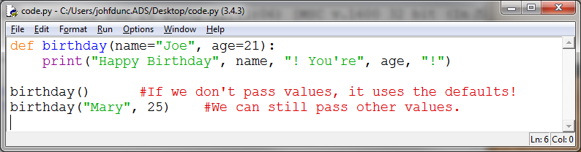
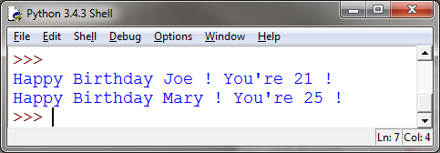
Default Argument Values
If there are common values that get passed in, we can save ourselves the trouble. We can make them default values!

Slide 4
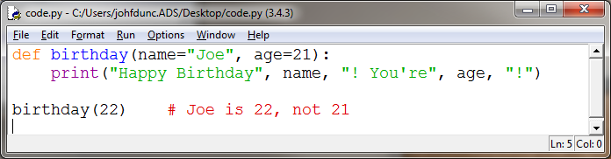
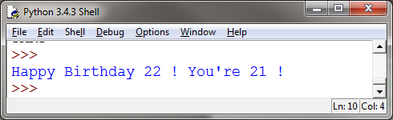
Default Arguments
What if we want to use one default argument, but specify the other one?
Oops! Looks like Python can’t tell what we meant.

Slide 5
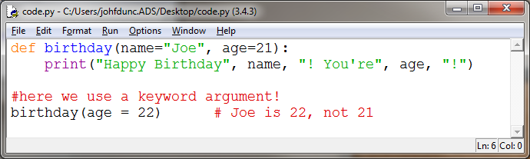
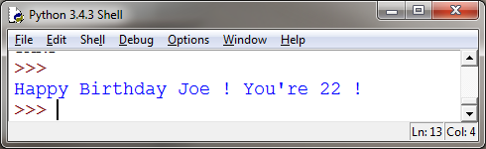
Keyword Arguments
To help Python out, we can indicate which argument we’re specifying. This is called a keyword argument.

Slide 6
Keyword Arguments
You might remember this use of keyword arguments: list.sort(reverse=True)
The implication from that is that .sort() has other arguments that we don’t normally give it – they have defaults! Let’s see an example.

Slide 7
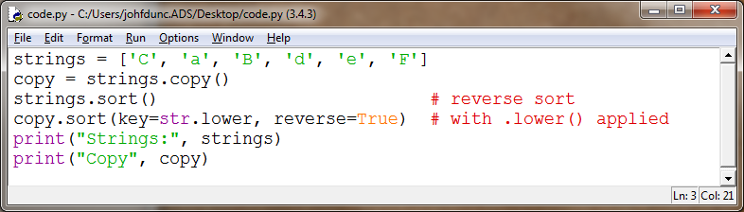
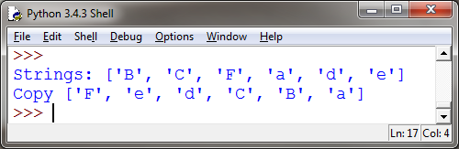
Keyword Arguments
We can also specify a function or method to be considered while sorting. This will treat all strings as if they were lowercase.

Slide 8
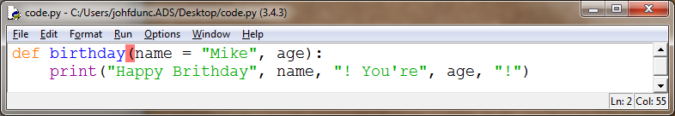
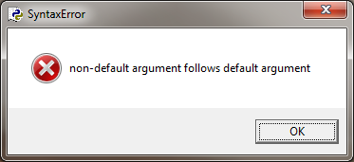
Positional or Keyword? (None or All)
Once you assign a default value to a parameter in the list, you must assign default values to all the parameters listed after it.
STYLE TIP: Assign default values to ALL parameters or NONE of them.

Slide 9
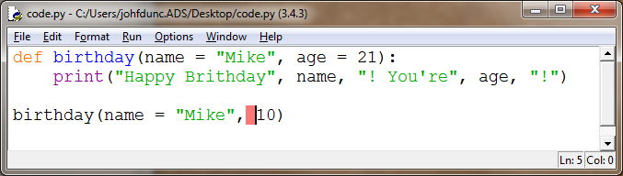
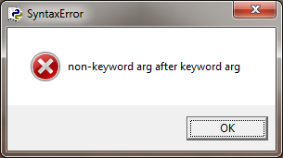
Positional or Keyword? (None or All)
Similarly, once you use a keyword argument, all the remaining arguments in the same call to the function must be keyword arguments.

Slide 10
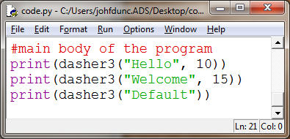
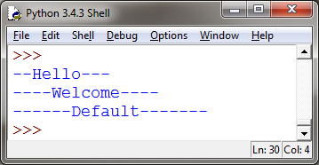
Dasher3 (Group Work) *
Alter the dasher2 function so that the total line length is an argument to the function.
Give this argument a default value of 20.
TIP: This does not involve changing much code! Where did you use the number 20? Change it to the new argument.

Slide 11
Dasher3 (Algorithm)
define a function that takes a string and a length (default 20)
check to see if the string is too long
if so, handle it with an error message
compute the number of dashes as (length – length of string)
start with half the dashes
add the string from the user
add the other half of the dashes
was the number of dashes odd?
add an extra dash if so
return the string

Slide 12
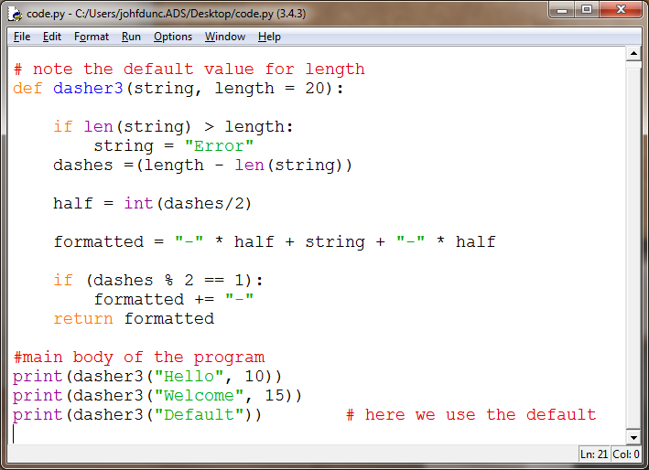
Dasher3 (Solution)

Slide 13
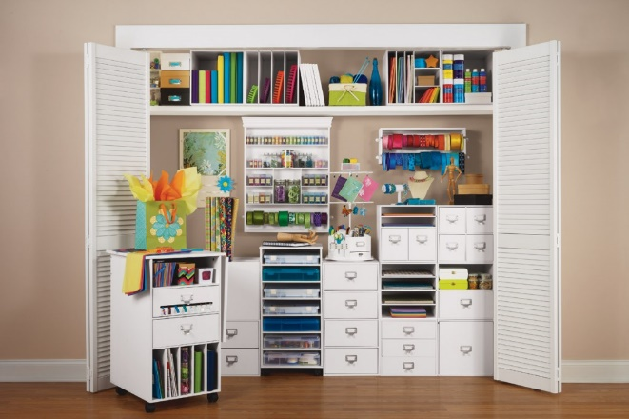

Managing Code
As our programs grow larger, we'll be writing and using more and more functions, and our code will get longer and longer…
Python lets us split a program into multiple source code files, to help keep organized.
Organized tools are more likely to get used!

Slide 14
Modules
module – a single file that contains a large collection of code
Modules can be used by importing them, at which point the code becomes part of the current program.
We’ve already seen the math module! Last time you saw the cards module as well.

Slide 15

Why Modules?
Reuse code
We especially want to reuse functions for different programs
Organize & Manage code
Large projects can be hundreds of thousands of lines long
Would be impossible to maintain in one file
Share code
If you write great code, distributing it as a module makes it easier for others to use
In python, it’s easy to create your own modules!

Slide 16
Writing Modules
A module is a collection of related programming components, like functions, in a single file.
The secret is… you’ve already written modules!
Any file with extension .py (so any python file) is a module!!
The file, games.py, can be imported as games .
The file, tools.py , can be imported as tools .
Anything in the same directory can be imported directly like this!

Slide 17
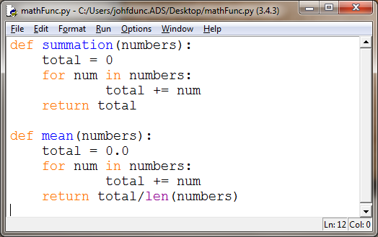
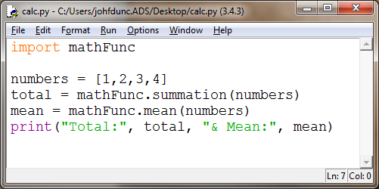
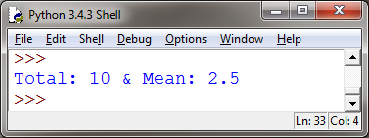
User-defined Modules
Let’s say we’ve written mathFunc.py .
Now we can use these functions in calc.py by importing them!
(This works because they’re in the same directory)

Slide 18
Modules
Modules contain groups of related functions:
math contains a lot of useful mathematical code
Modules can also contain classes or constants
math.pi
When we import a module we then have to say modulename.methodname()
i.e. mathFunc.summation(numbers)

Slide 19
3 Ways to Import
import mathFunc #standard import
mathFunc.summation([1,2,3])
import mathFunc as mfn #we can rename
mfn.summation([1,2,3]) #a module on import
from mathFunc import * #global import!
summation([1,2,3]) #we don't need to use a prefix
The one downside to a global import is that you can’t have functions in the current file with the same name!

Slide 20
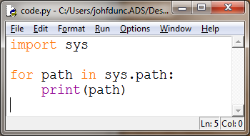
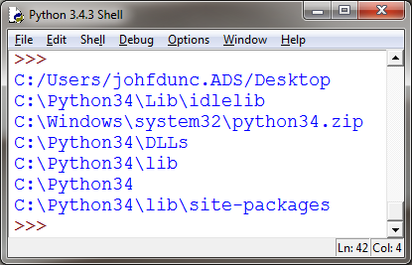
Module Not Found?
When you tell python to import a module, the interpreter searches in a list of directories specified by sys.path :
(Where the code is running!)

Slide 21
Module Not Found?
You can also modify this list directly to tell python to look for modules in other directories:
import sys
sys.path.append('/home/jd/lib/python')
OR
sys.path.append('c:/users/J/Desktop/I210/')

Slide 22
What about Test Code in main?
def summation(numbers):
total = 0
for num in numbers:
total += num
return total
def mean(numbers):
total = 0.0
for num in numbers:
total += num
return total/len(numbers)
#test code
nums = [1,2,3,4]
print(summation(nums) == 10)
print(mean(nums) == 2.5)
Let’s say I add some test code to my mathFunc module.
This code is written so that if I run the module directly, I expect all of my tests to return True.
Now if I import this module, it runs the test code, too!!

Slide 23
What about Test Code in main?
def summation(numbers):
total = 0
for num in numbers:
total += num
return total
def mean(numbers):
total = 0.0
for num in numbers:
total += num
return total/len(numbers)
#test code
if __name__ == "__main__":
nums = [1,2,3,4]
print(summation(nums) == 10)
print(mean(nums) == 2.5)
Adding a single line prevents the test code from running when the module is imported!
This way, we can keep our test code AND have the module be useful.

Slide 24
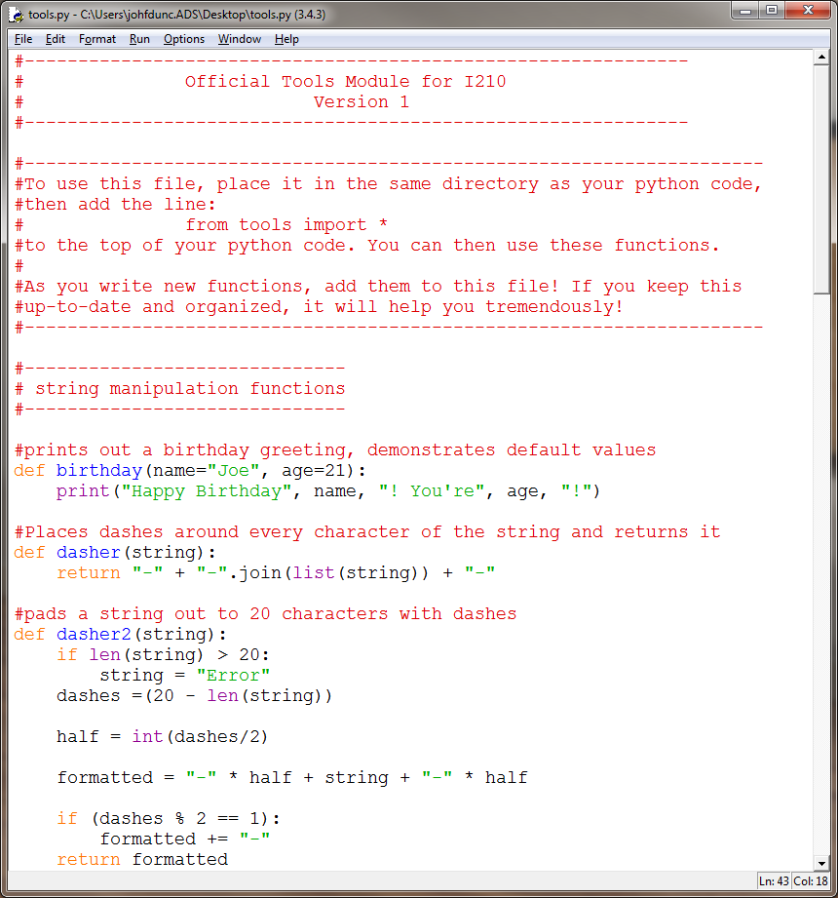
tools.py - Shared Tool Codebase
I’ve placed all the functions we’ve done together in a file called tools.py on Canvas.
If you maintain this…
test.py :
from tools import *
print(dasher("test"))

Slide 25
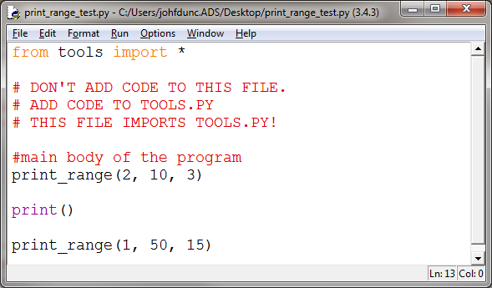
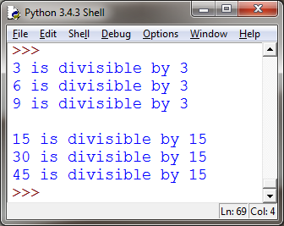
Print Range (Group Work)*
Add a function to tools.py in the Printing Functions section:
The function should be called print_range(low, high, factor)
It prints (not returns) all of the integers from low to high that are divisible by factor.
Call the function from the file print_range_test.py
Notice we’re importing tools.py

Slide 26
Print Range (Algorithm)
Define a function called print_range that takes three values: low, high, and factor
Walk over all of the integers in that range
If the integer is evenly divisible by the factor
Print out a message

Slide 27
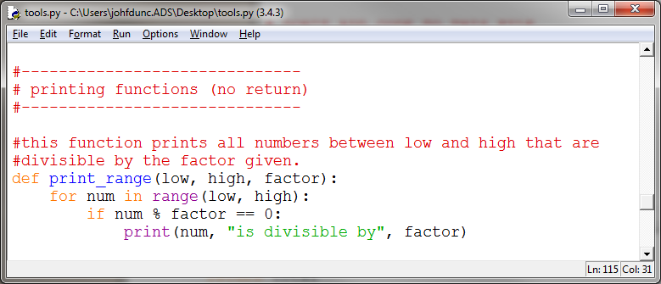
Print Range (Solution)

Slide 28
Questions?

